Slide 1
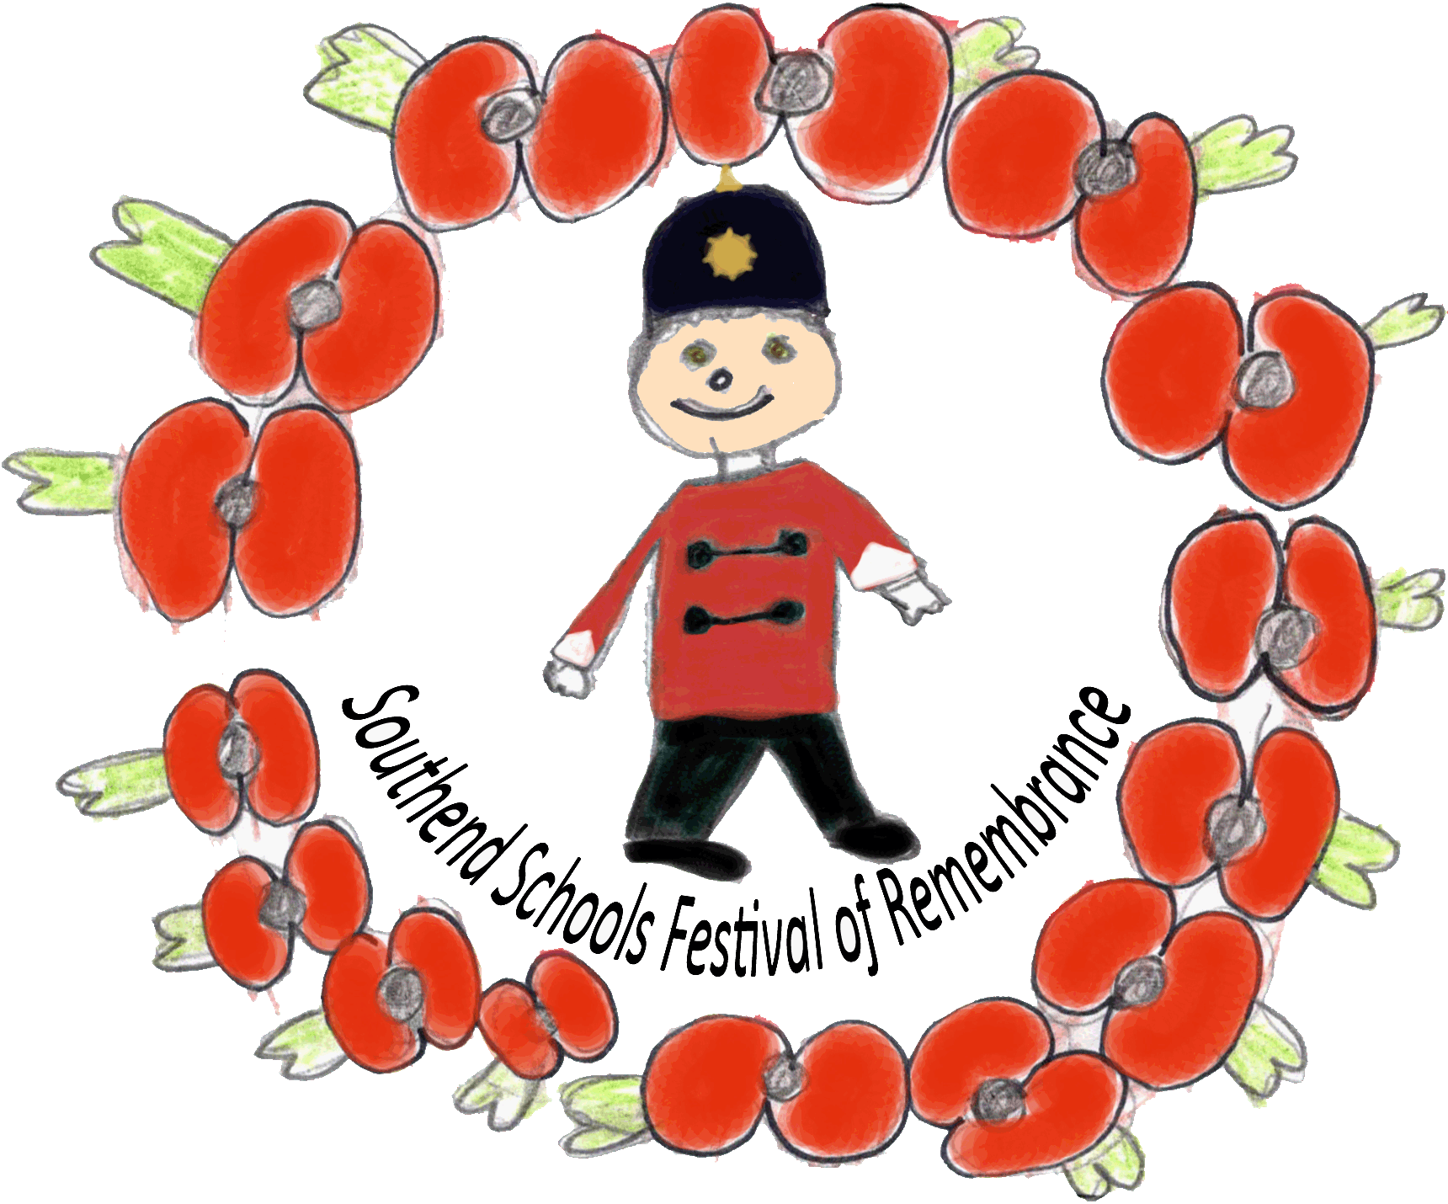
The Christmas Truce
Southend Schools Festival of Remembrance Learning Materials

Slide 2
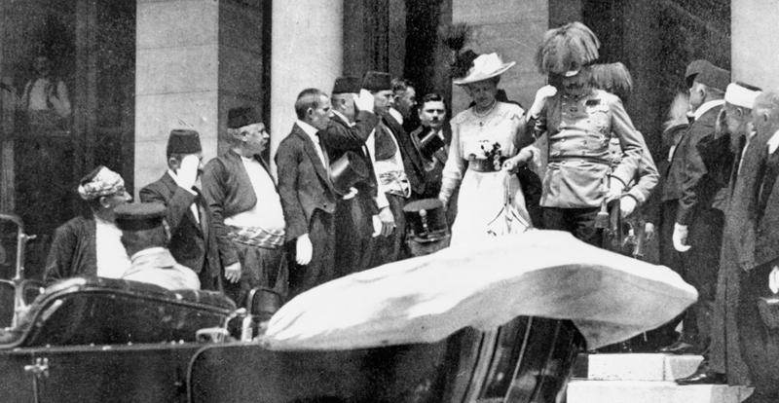
Prelude to war
On 28 June 1914, Archduke Franz Ferdinand, the heir to the Austro-Hungarian throne, and his wife were assassinated by a Serbian-backed terrorist. During the crisis that followed, Europe's leaders made a series of political, diplomatic and military decisions that would turn a localised conflict in south-east Europe into a global war.
Austria-Hungary, with German encouragement, declared war on Serbia on 28 July. Russia's support of Serbia brought France into the conflict. Germany declared war on Russia on 1 August and France on 3 August.
Archduke Franz Ferdinand and his wife descending the steps of the City Hall, Sarajevo, to their motor car, 28 June 1914.

Slide 3
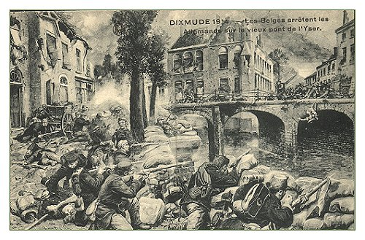
3 Aug 1914
Germany declared war on France. German troops poured into Belgium. The British foreign secretary, Sir Edward Grey, sends an ultimatum to Germany demanding their withdrawal from the neutral Belgium.
This postcard shows Belgian soldiers fighting the German army at Dixmude (now Diksmuide) in Belguim.

Slide 4
4 Aug 1914
Germany refuses to withdraw from Belgium Britain declared war on Germany.
“At midnight on August 4th, 1914, there were crowds outside the offices of the Southend Standard waiting for news of England’s declaration of war on Germany due to the unprovoked invasion of Belgium.” EXTRACT FROM “SOUTHEND AT WAR”

Slide 5
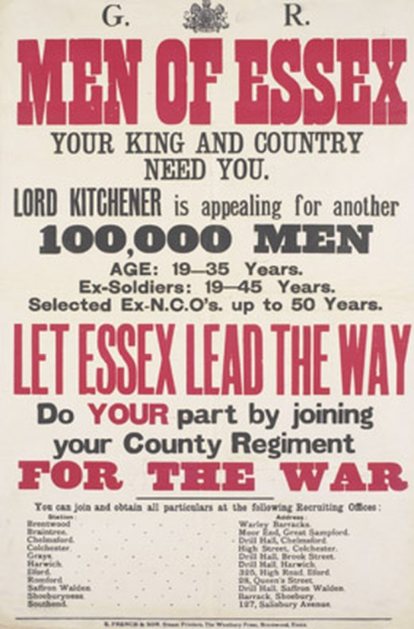
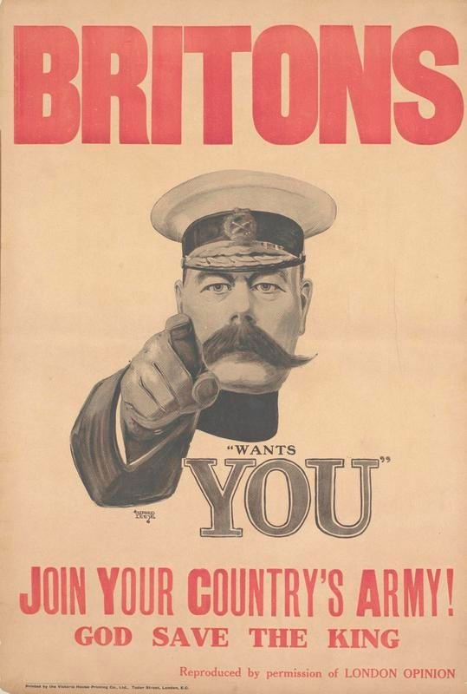
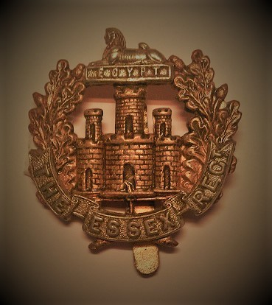
Signing Up
After the outbreak of the Great War in 1914, there was a huge rush to join up. Recruitment posters and films were everywhere extolling men to do their patriotic duty.
During the Great War, the Essex Regiment provided 30 infantry battalions to the British Army.
Resource: IWM Signing Up Podcast

Slide 6
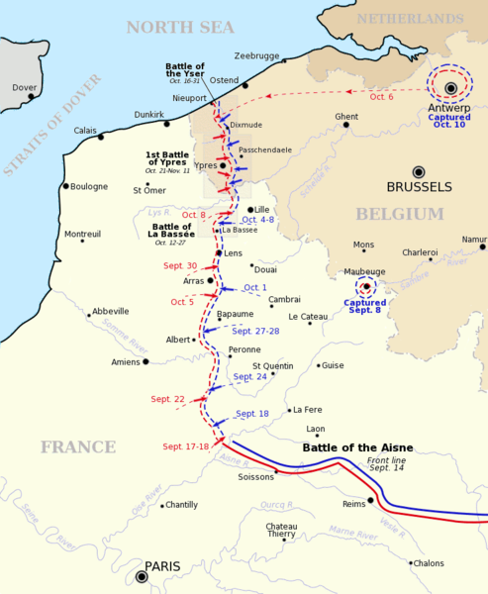
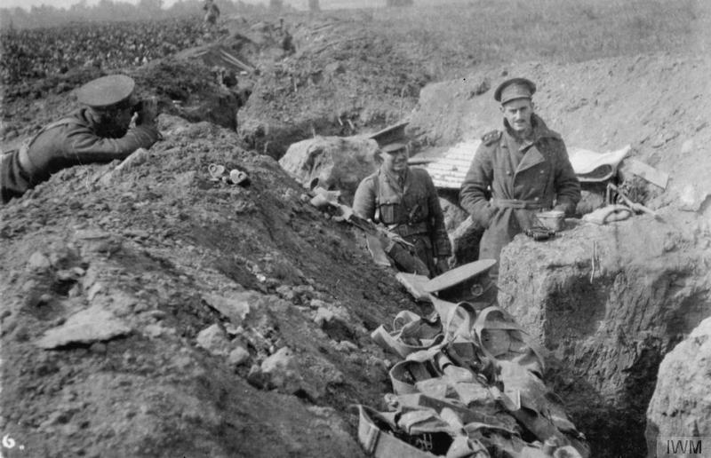
The Western Front
The Western Front was a line of entrenched fortifications that ran through France and Belgium.
2nd Battalion the Essex Regiment in a front line trench at St Marguerite 17 September 1914.
Western Front Map 1914

Slide 7
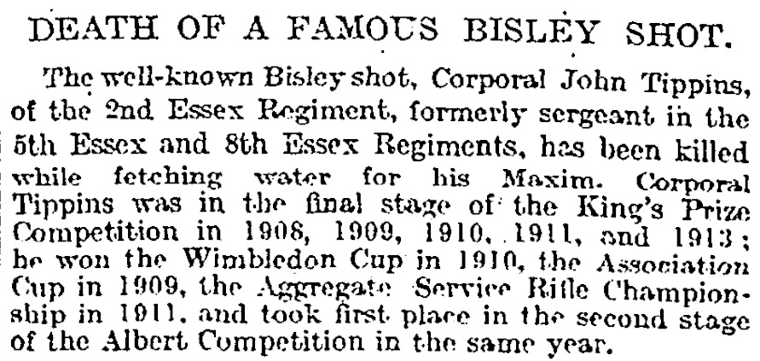
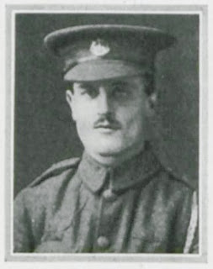
December 1914
By December 1914, trench warfare became the norm for life on the Western Front. It was cold, it was wet, it was dangerous. As this Times newspaper report from 23rd December 1914 shows:
Cpl John Tippins

Slide 8
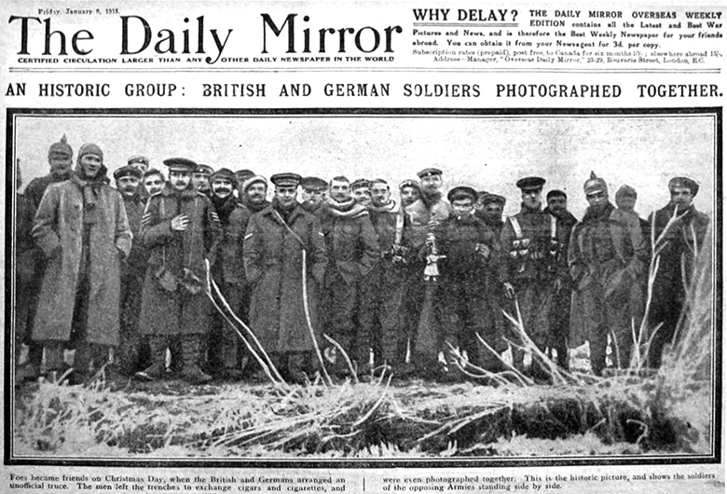
Christmas 1914
So it came as surprise when on Christmas Day 1914, in many places no one was shooting at each other. This went on for many hours until, as the story goes both sides climbed out of their trenches and met in No-man’s Land.

Slide 9
Christmas 1914
Most of the stories written about the Christmas Truce by from people who weren’t actually there – but one person who was an eyewitness to the Christmas Truce was Private Henry Williamson, who was in a British trench on the Western Front. Henry Williamson Interview Link

Slide 10
Activities
Activity: Creative Writing – 1914 Christmas Truce Time: 30minutes Resources: War Interview with Henry Williamson who took part in the truce: Henry Williamson Interview Link and the story of the truce: www.youtube.com During Christmas 1914 soldiers in the trenches stopped shooting each other and eventually met in No Man’s Land. They swapped gifts and despite the language barrier discovered that the English and German soldiers were very much alike. Pupils can watch the interview with Henry Williamson, who was a Private in the London Regiment in 1914 during the truce. Pupils may then write a short story about how they think they would have felt if they were taking part in the Christmas Truce.

Slide 11
Teacher’s Notes:
The Christmas Truce. The Christmas Truce has become one of the most famous and mythologised events of the First World War. But what was the real story behind the truce? Why did it happen and did British and German soldiers really play football in no-man's land?
Late on Christmas Eve 1914, men of the British Expeditionary Force (BEF) heard German troops in the trenches opposite them singing carols and patriotic songs and saw lanterns and small fir trees along their trenches. Messages began to be shouted between the trenches.
The following day, British and German soldiers met in no man's land and exchanged gifts, took photographs and some played impromptu games of football. They also buried casualties and repaired trenches and dugouts. After Boxing Day, meetings in no man's land dwindled out.
The truce was not observed everywhere along the Western Front. Elsewhere the fighting continued and casualties did occur on Christmas Day. Some officers were unhappy at the truce and worried that it would undermine fighting spirit.
After 1914, the High Commands on both sides tried to prevent any truces on a similar scale happening again. Despite this, there were some isolated incidents of soldiers holding brief truces later in the war, and not only at Christmas.
In what was known as the 'Live and Let Live' system, in quiet sectors of the front line, brief pauses in the hostilities were sometimes tacitly agreed, allowing both sides to repair their trenches or gather their dead.
(Article from IWM)

Slide 12
Great War Christmas Truce
Southend Schools Festival of Remembrance
www.ssfr.org.uk

