Slide 1
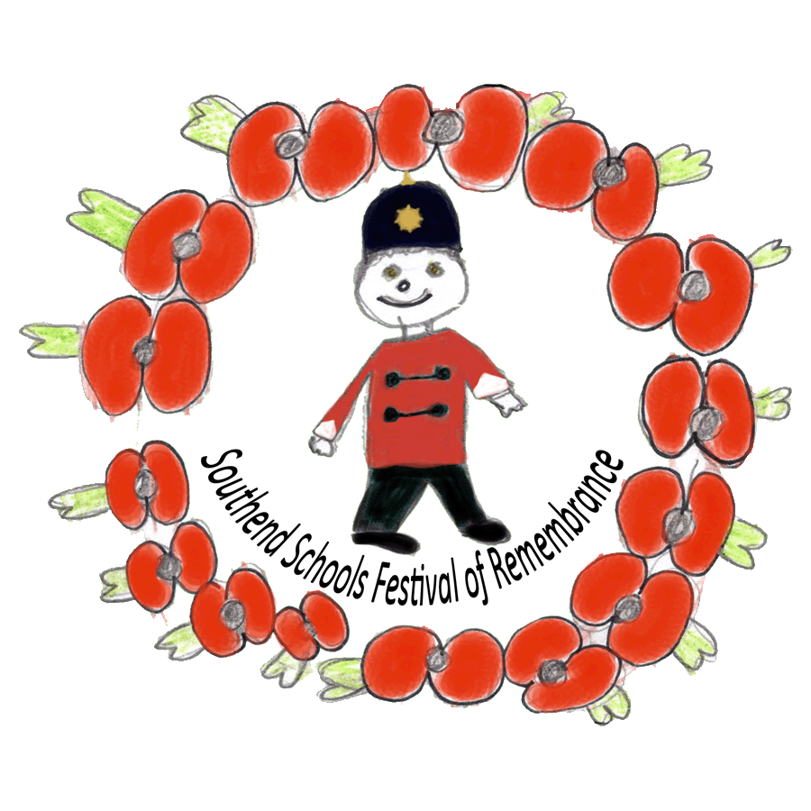
An introduction to Remembrance
Southend Schools Festival of Remembrance Learning Materials

Slide 2
SSFR: An introduction to Remembrance
Engaging children with Remembrance – Family History
A good way to engage with Remembrance is to work with children on their own family history. Most of them will know who their parents and grandparents are and by asking them to start with those connections and then going home and talking to their parents and grandparents, they can build up a family tree that will take them back to a time when someone related to them served either in the armed forces during WW1 or WW2, or stayed at home and lived life during the war on the Home Front.
If they are able to find out about a relative that lived or died at that time, they then have a personal link to Remembrance and if they can research the lives of either their relatives through talking to their family, or through the movements of their service unit, they can begin to get a feel for how life was both at the battle and home fronts.

Slide 3
SSFR: An introduction to Remembrance
Engaging children with Remembrance – Family History
Activities – Family Tree and research Duration – 20 mins, homework, 30 mins Resources – https://www.ssfr.org.uk/learningmaterials Ask each child to fill in as much of their family tree as they can in lesson time. Allow for complicated family situations, but try to keep things simple as possible. As homework ask each child to take their family tree home and work with their parents or grandparents to fill in the rest of the generations back to the early 1900s. Request that they copy any photos of old relatives and find out some details about them. Back in class have them identify a family member they would like to remember and write up as much as they know about their lives.

Slide 4
Resources – Research sheet example

Slide 5
SSFR: An introduction to Remembrance
Remembrance is different from remembering. Remembering is something we all do all of the time and is a part of the process of learning and forming our personalities based around our experiences. Remembrance is a deliberate act that we use to give our thanks to those who gave their lives so that we can live as we do today. You can remember what you had for breakfast, but in Remembrance you remember someone important to you who gave their lives for our freedom. Remembrance as we know it today started after the end of World War 1.

Slide 6
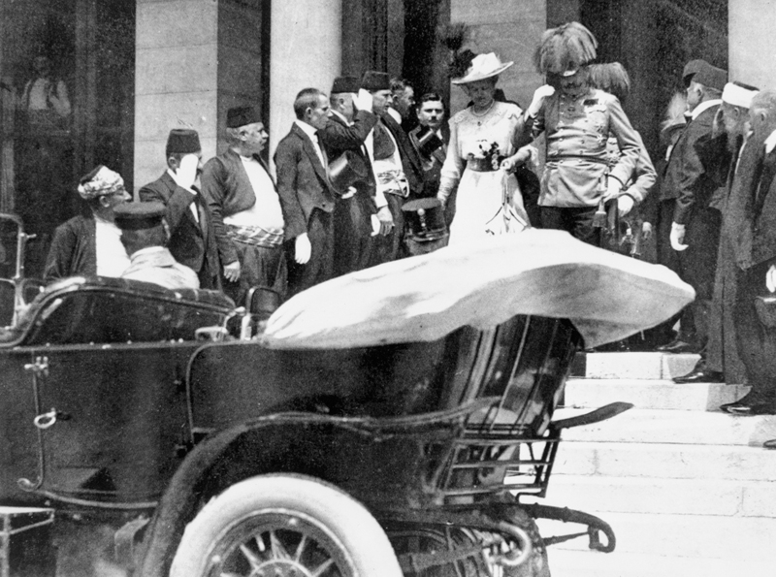
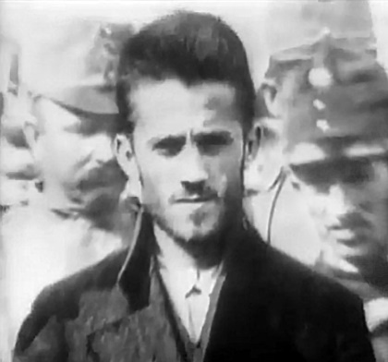
SSFR: An introduction to Remembrance
This photograph was taken in Sarajevo shortly before the assassination of Archduke Franz Ferdinand of Austria, and his wife Sophie, Duchess of Hohenberg, who were fatally wounded by gunfire from Gavrilo Princip (below).

Slide 7
SSFR: An introduction to Remembrance
At the moment most of the Remembrance events are about remembering the people who gave their lives during World War 1 – or the Great War as it was called at the time. The Great War started for Great Britain in August 1914 and continued for over 4 years at the cost of millions of lives. This year we are remembering the Armistice, that came into effect at 11am on the 11th November 1918 – an good memorable date. Although the vast majority of fighting stopped in November 1918, the final peace treaty wasn’t signed until June 1919. 5 years to the day from the assassination that began the conflict.

Slide 8
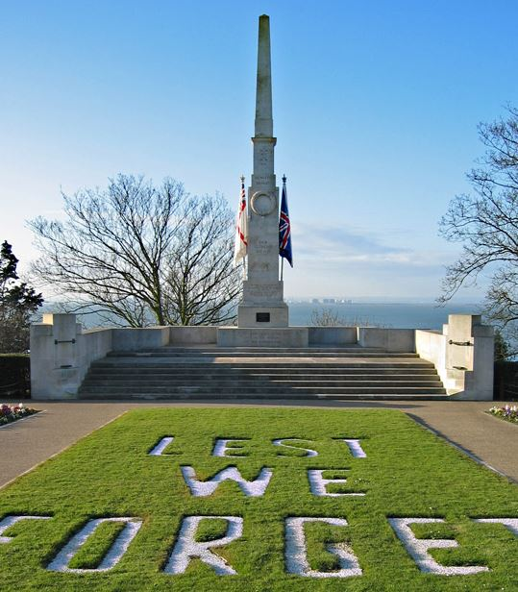
SSFR: An introduction to Remembrance
The most important date for Remembrance in England is the 11th November, where as a nation, in villages, towns and cities across the country people gather at their local war memorial or cenotaph to pay tribute to those who gave their lives in wars and conflicts since the Great War.
After the Great War, thousands of war memorials were built across Britain. Amongst the most famous designers of memorials was architect Sir Edwin Lutyens, who designed the Cenotaph in London and the Southend Cenotaph, which cost just over £5,500 in 1921.
Southend Cenotaph

Slide 9
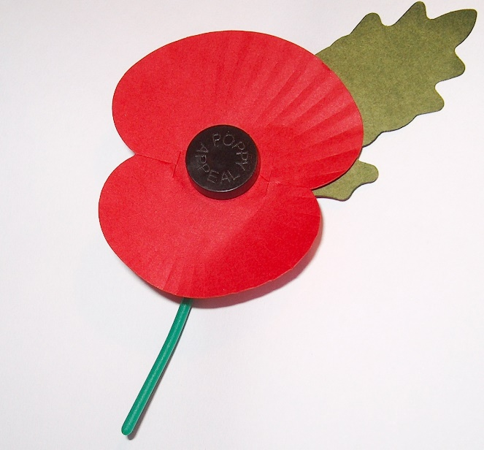
SSFR: An introduction to Remembrance
In Great Britain the symbol adopted for Remembrance is the Poppy.
During the First World War much of the fighting took place in Western Europe. Previously beautiful countryside was blasted, bombed and fought over, again and again. The landscape swiftly turned to fields of mud: bleak and barren scenes where little or nothing could grow. Bright red common poppies grew in their thousands, flourishing even in the middle of chaos and destruction. In early May 1915, shortly after losing a friend in Ypres, a Canadian doctor, Lt Col John McCrae was inspired by the sight of poppies to write a now famous poem called 'In Flanders Fields’.
McCrae’s poem inspired an American academic, Moina Michael, to make and sell red silk poppies which were brought by the (Royal) British Legion, that ordered 9 million poppies and sold them on 11 November that year. The poppies sold out almost immediately and that first ever 'Poppy Appeal' raised over £106,000; a considerable amount of money at the time. This was used to help WW1 veterans with employment and housing. From the history of the Poppy by the Royal British Legion www.britishlegion.org.uk

Slide 10
SSFR: An introduction to Remembrance
In Flanders' fields the poppies blow Between the crosses, row on row, That mark our place: and in the sky The larks, still bravely singing, fly Scarce heard amid the guns below.
We are the dead. Short days ago We lived, felt dawn, saw sunset glow, Loved and were loved, and now we lie In Flanders' fields.
Take up our quarrel with the foe; To you from failing hands we throw The torch; be yours to hold it high, If ye break faith with us who die We shall not sleep, though poppies grow In Flanders' Fields.
In Flanders Fields by Lt. Col. John McCrea

Slide 11
SSFR: An introduction to Remembrance
The British Legion was formed on 15 May 1921, the main purpose of the Legion was to care for those who had suffered as a result of service in the Armed Forces during the war, whether through their own service or through that of a husband, father or son. Over six million men had served in the war - 725,000 never returned. Of those who came back, 1.75 million had suffered some kind of disability and half of these were permanently disabled. When the Legion's leaders looked around them, they saw the gigantic task of looking after those who had suffered in the recent war and also the need to prevent further sacrifice by reminding the nation of the human cost of war and to work actively for peace.
By the time of the Legion's formation in 1921, the tradition of an annual Two Minute Silence in memory of the dead had been established. The first ever Poppy Appeal was held that year, with the first Poppy Day on 11 November 1921.
The British Legion were granted ‘Royal’ status in 1917 and extended their membership to serving members of Her Majesty's Armed Forces, as well as ex-Service personnel, in 1981. Now, anyone can become a member of The Royal British Legion. From the history of the Royal British Legion www.britishlegion.org.uk

Slide 12
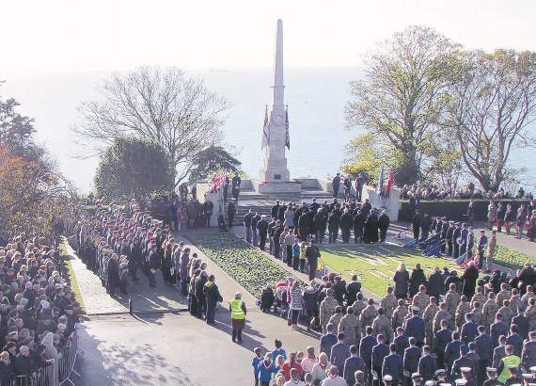
SSFR: An introduction to Remembrance
The Royal British Legion is the ‘custodian’ of Remembrance in the U.K and it’s members from local branches across the country raise money and hold events to help ex-servicemen and women and to act as a voice for the families of service personnel from across the world.
Thousands of community members from across the borough attending the annual Remembrance Sunday commemoration at Southend Cenotaph.

Slide 13
SSFR: An introduction to Remembrance
Before the First World War it was the fate of the ‘ordinary’ soldier to be forgotten. Even when the Great War started, there was no system or organisation in place to mark or care for the graves of servicemen and women. Fabian Ware the editor of the Morning Post and at 45 years old was to old to enlist in 1914. So he volunteered to command a mobile unit of the British Red Cross, ferrying wounded men back from the frontline to dressing stations and hospitals. Each day his unit would drive past makeshift graves and improvised cemeteries, and Ware wanted to find a way to ensure the final resting places of the dead would not be lost forever. His unit began recording the locations of graves and the identity of those buried there. By 1915 it was given official recognition by the War Office and was incorporated into the British Army as the Graves Registration Commission.

Slide 14
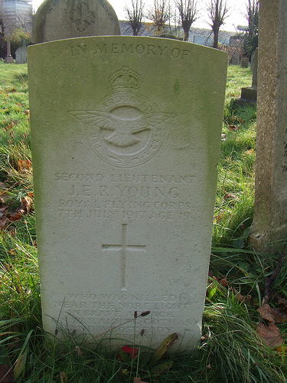
SSFR: An introduction to Remembrance
The Commonwealth War Graves Commission honours the 1.7 million men and women of the Commonwealth forces who died in the First and Second World Wars, and ensures they will never be forgotten. Their work includes maintaining cemeteries and memorials at 23,000 locations in more than 150 countries and territories around the world.
The CWGC's principles are:
Each of the dead should be commemorated by name on the headstone or memorial
Headstones and memorials should be permanent
Headstones should be uniform
There should be no distinction made on account of military rank, race or creed
From www.cwgc.org/about-us
CWGC memorial of 2nd Lt. J.E.R Young who died on 17th July 1917, aged 19.

Slide 15
An introduction to Remembrance
Southend Schools Festival of Remembrance
www.ssfr.org.uk

