Slide 1
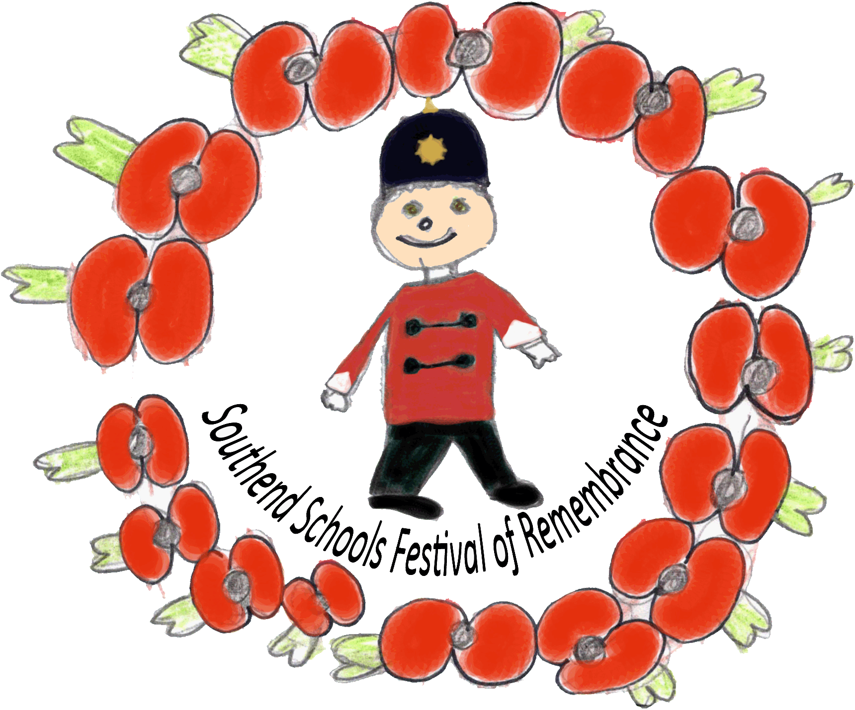
Great War Christmas Cards
Southend Schools Festival of Remembrance Learning Materials

Slide 2
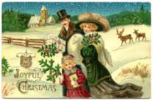
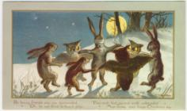
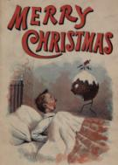
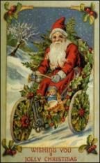
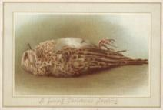
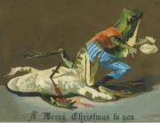
Christmas Cards before the war.

Slide 3
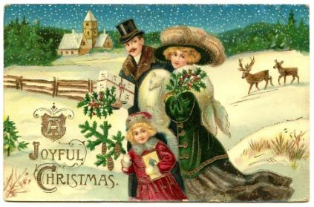
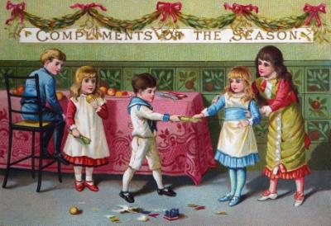
Christmas Cards before the war.
The Victorians had some very nice Christmas Cards, but they only showed rich people.

Slide 4
Christmas Cards before the war.
And there were some very creepy Victorian Christmas Cards.

Slide 5
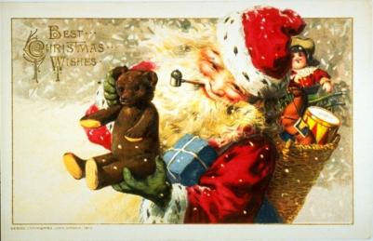
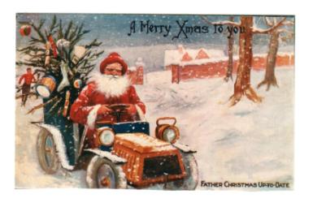
Christmas Cards before the war…
Fortunately between 1901 and 1913 things got a little nicer.

Slide 6
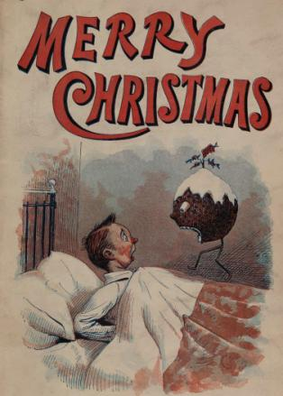
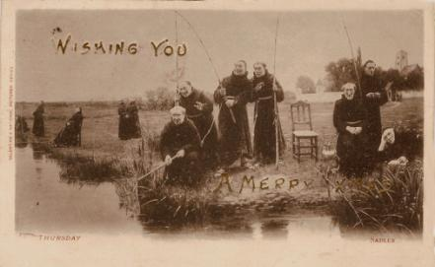
Christmas Cards before the war…
Although I’m not sure if I’d have liked getting these.

Slide 7
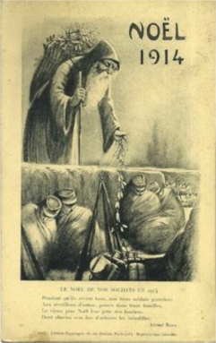
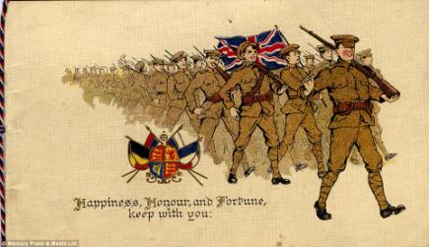
Christmas Cards at the start of the war.
At Christmas 1914 the cards started to be more military and patriotic.

Slide 8
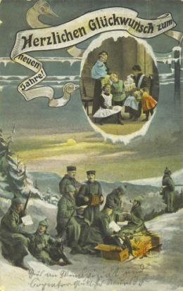
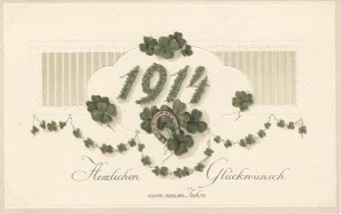
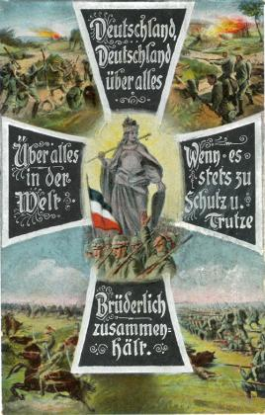
Christmas Cards at the start of the war.
Of course it wasn’t only the English that had Christmas Cards.

Slide 9
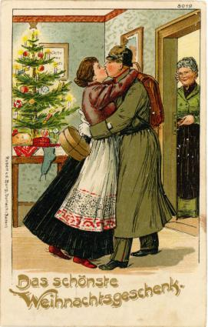
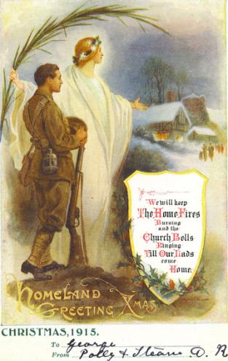
Christmas Cards during the Great War.
As the war went on people began to concentrate more on their loved ones coming homes safely.

Slide 10
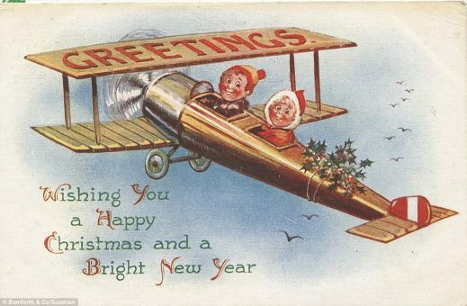
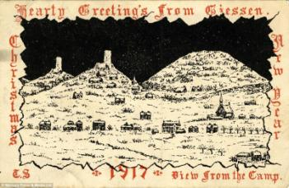
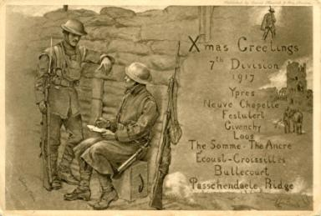
Christmas Cards during the Great War.
Soldiers sent postcards back to their family.

Slide 11
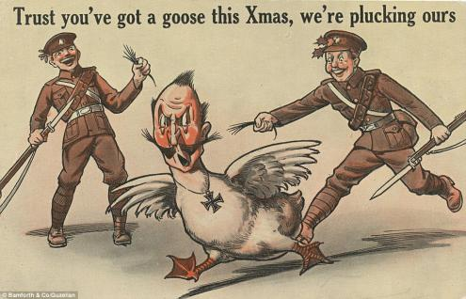
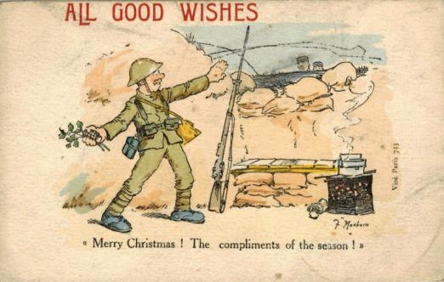
Christmas Cards during the Great War.
Propaganda was used to make people think that the war was all the fault of the Germans and that their leaders were stupid or ridiculous. It was used on both sides to make people happier and to make them hate the Germans and love their own country and support the war.

Slide 12
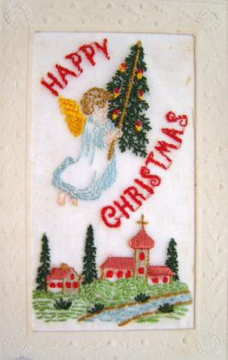
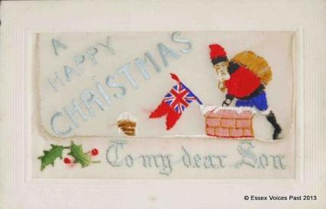
Christmas Cards during the Great War.
As the war went on it became harder to buy Christmas Cards because factories were concentrating on the war effort. So people made their own cards.

Slide 13
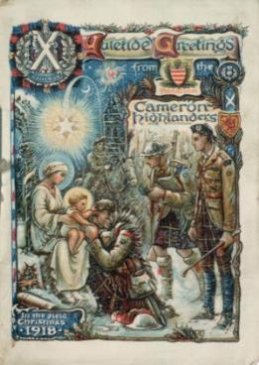
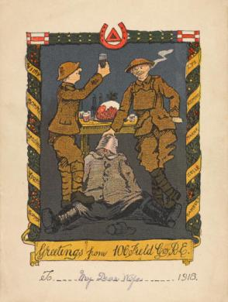
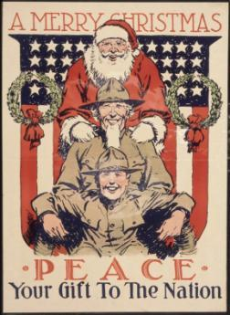
Christmas Cards during the Great War.
By Christmas 1918, the Armistice had been signed, but many soldiers were still not home, but Christmas Cards were more cheerful again.

Slide 14
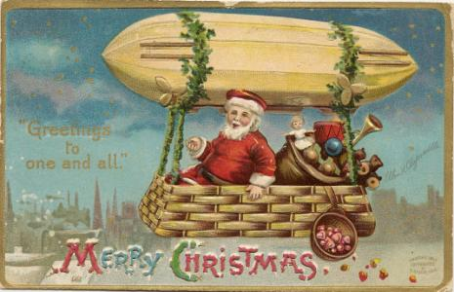
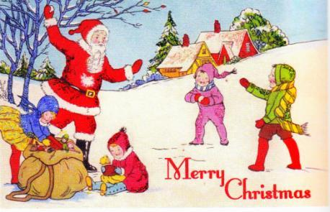
Christmas Cards after the Great War.
After the war Christmas Cards became much more as we know them now.

Slide 15
Activities
Activity: Great War Christmas Card Making Time: 20minutes Resources: A4 paper, colouring pencils. Pupils of all ages may be asked to take a sheets of A4 paper or a page in a drawing book and design their own Great War Christmas Card. If using A4 paper, each child should fold the paper in half, either vertically or horizontally and then use the front of the folded paper to draw their Great War Christmas Card design. If you have card available then pupils should write on the inside of the card to a family member and take the card home to give them.

Slide 16
Activities
Activity: Creative Writing – 1914 Christmas Truce Time: 30minutes Resources: War Interview with Henry Williamson who took part in the truce: Henry Williamson Interview Link and the story of the truce: www.youtube.com During Christmas 1914 soldiers in the trenches stopped shooting each other and eventually met in No Man’s Land. They swapped gifts and despite the language barrier discovered that the English and German soldiers were very much alike. Pupils can watch the interview with Henry Williamson, who was a Private in the London Regiment in 1914 during the truce. Pupils may then write a short story about how they think they would have felt if they were taking part in the Christmas Truce.

Slide 17
Teacher’s Notes:
The Victorian Christmas Card. Murderous frogs, children boiled in teapots and a dead birds are generally not images seen today on Christmas card, but in Victorian times it was all par for the course. The first Christmas cards were produced 1843 but it was not until the 1870s, and the introduction of the halfpenny stamp, that sending cards was affordable for almost everyone – and the Victorians leapt upon the idea.
It was usual in the 19th Century for friends and relations to exchange letters at Christmas time. They would tell of the year's events and their wishes for the coming year. Cards were cheap and cheerful, leading to a real fad of sending greetings in such a way. There was a huge amount of material, publishers would produce loads and loads. Popular images were reused and reprinted as Christmas cards, even if they weren't particularly festive. The cards were not only overwhelmingly secular, but some were grimly non-festive. Rosy-faced children gathered round a decorated tree might be seen on a card - but so might a dead robin or a turnip wearing a hat. Food featured a lot - not just in family feasts and traditional spreads and what could be more seasonal than a child boiled in a teapot? Perhaps a malevolent clown about to assault a policeman with a red hot poker. Christmas is a time for mirth, the card on the right reminds us. This merriment is expressed by two ladies rolling an elderly man in snow. So why were such odd things depicted? The Victorians had a different idea to what Christmas was about - not particularly Christian, but a time of good humour. You may find a mouse riding a lobster strange - we find it funny, but its horses for courses. Of course, there were also cards more like the ones we post today - with frosty scenes, Father Christmas and family get-togethers. For all the more unusual ones, there were probably 100 entirely Christmassy ones. It's just the unusual ones which stand out. (Extracted from article by Bethan Bell, BBC Online.)

Slide 18
Teacher’s Notes:
The Christmas Truce. The Christmas Truce has become one of the most famous and mythologised events of the First World War. But what was the real story behind the truce? Why did it happen and did British and German soldiers really play football in no-man's land?
Late on Christmas Eve 1914, men of the British Expeditionary Force (BEF) heard German troops in the trenches opposite them singing carols and patriotic songs and saw lanterns and small fir trees along their trenches. Messages began to be shouted between the trenches.
The following day, British and German soldiers met in no man's land and exchanged gifts, took photographs and some played impromptu games of football. They also buried casualties and repaired trenches and dugouts. After Boxing Day, meetings in no man's land dwindled out.
The truce was not observed everywhere along the Western Front. Elsewhere the fighting continued and casualties did occur on Christmas Day. Some officers were unhappy at the truce and worried that it would undermine fighting spirit.
After 1914, the High Commands on both sides tried to prevent any truces on a similar scale happening again. Despite this, there were some isolated incidents of soldiers holding brief truces later in the war, and not only at Christmas.
In what was known as the 'Live and Let Live' system, in quiet sectors of the front line, brief pauses in the hostilities were sometimes tacitly agreed, allowing both sides to repair their trenches or gather their dead.
(Article from IWM)

Slide 19
Great War Christmas Cards
Southend Schools Festival of Remembrance
www.ssfr.org.uk

