Slide 1
The Guy Family Christmas
Southend Schools Festival of Remembrance Learning Materials

Slide 2
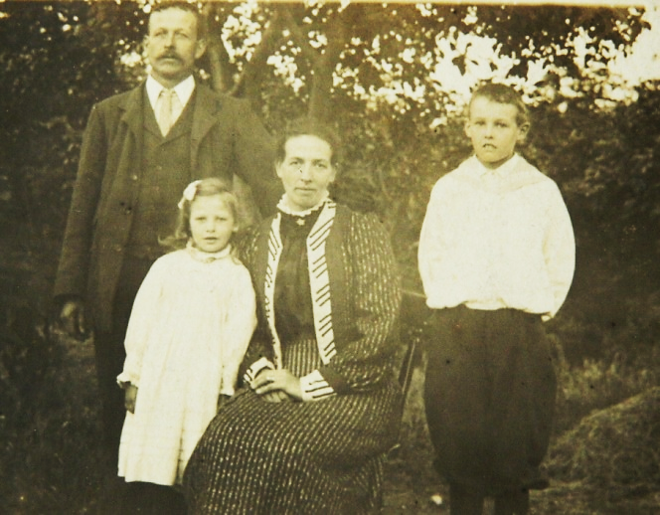
The Guy Family
(Left to right) Austin, Eva, Alice and George a few years before WW1.

Slide 3
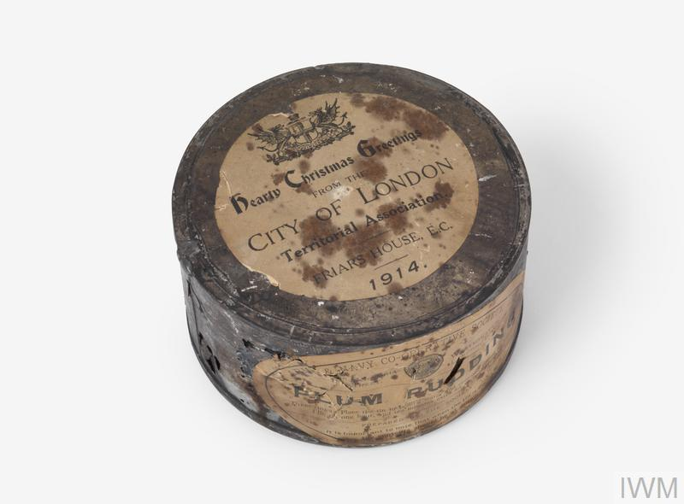
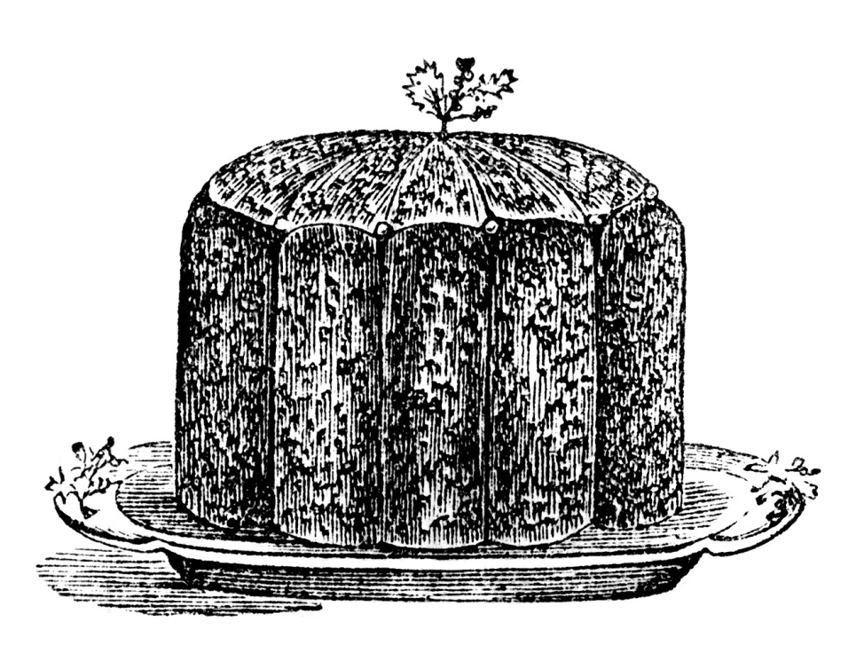
Christmas Preparations
At this stage in the war there would still have been tasty treats ready for Christmas - like plum puddings, as they would have been made months in advance and rationing hadn’t started. So the Guys would have scrimped and saved to have some of the special treats such as plum pudding and turkey on Christmas Day.

Slide 4
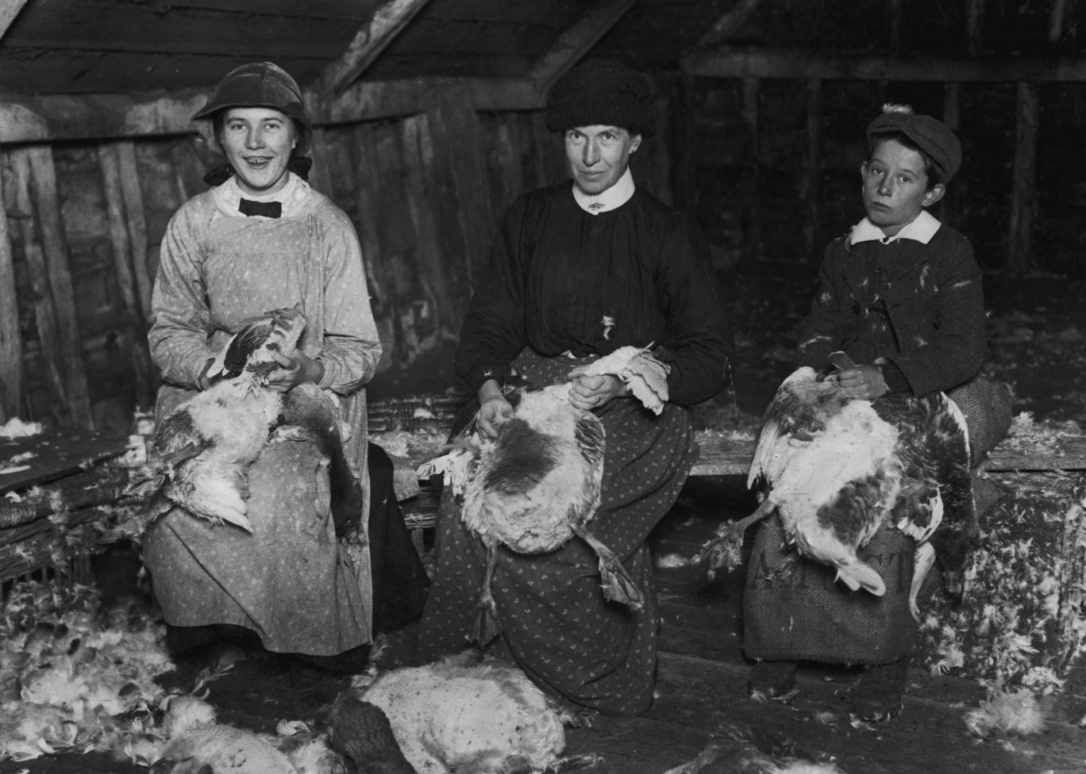
Christmas Preparations

Slide 5
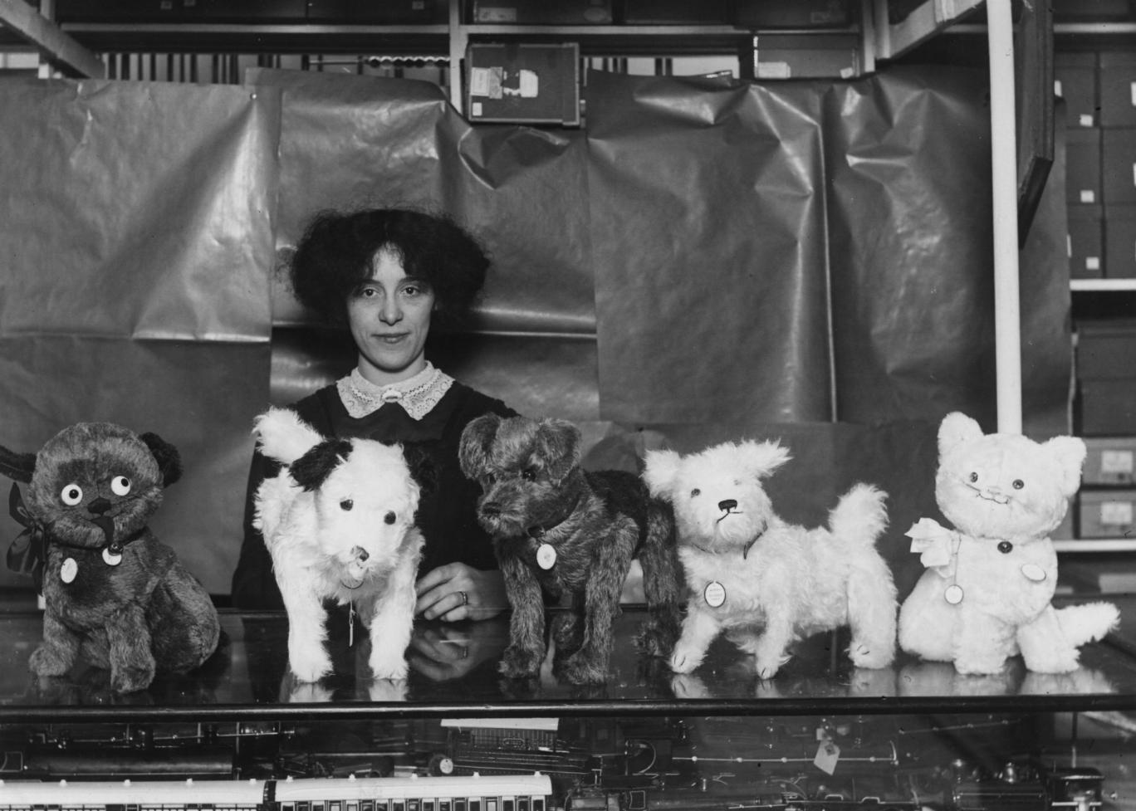
WW1 Christmas presents
Stockings would have been old socks or stockings hung by the fire. Children had much less expectation on the big day and would be lucky if they were given a small toy, a penny and a few sweets.
Books were also expensive and a great treat for those families that could afford them.

Slide 6
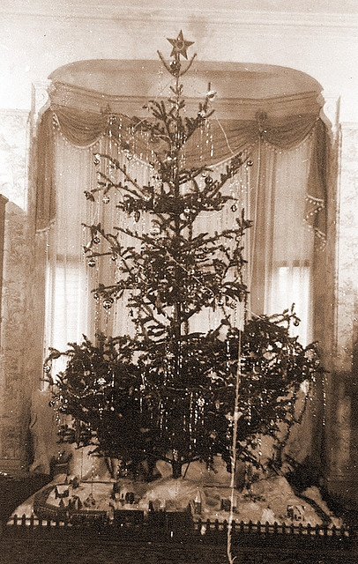
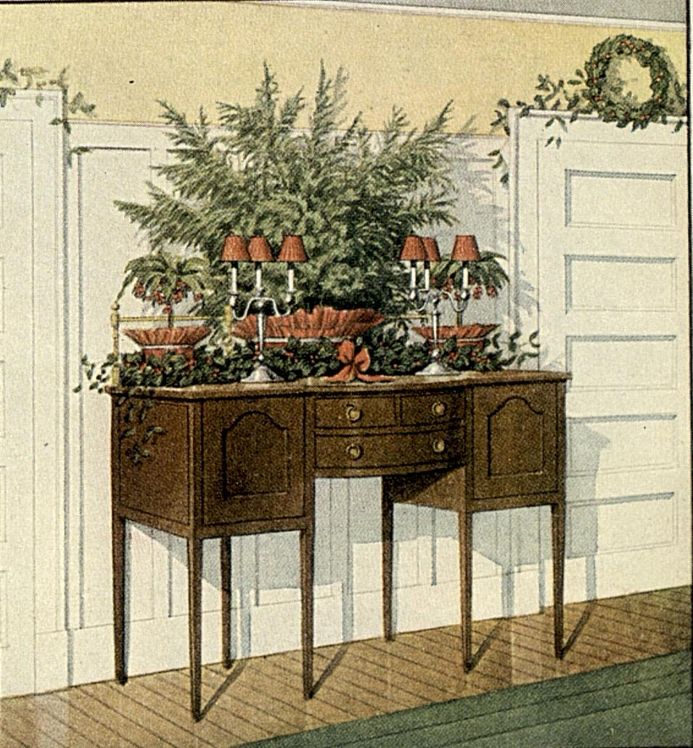
WW1 Christmas Decorations
There would have been no tinsel or plastic decorations but people made paper chains and brought evergreen plants into the house such as holly, ivy and mistletoe. The Christmas tree, when it could be afforded, would have candles on the branches, which would smell wonderful when lit but be rather dangerous if left unattended!

Slide 7
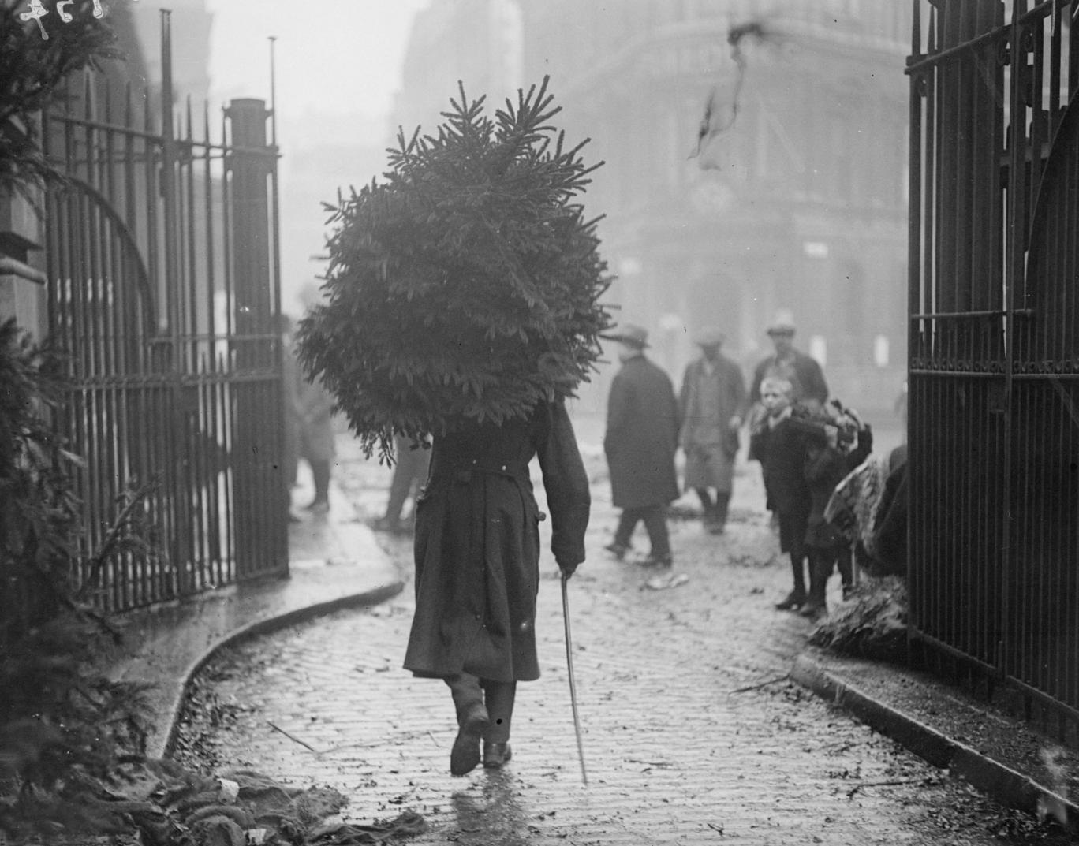
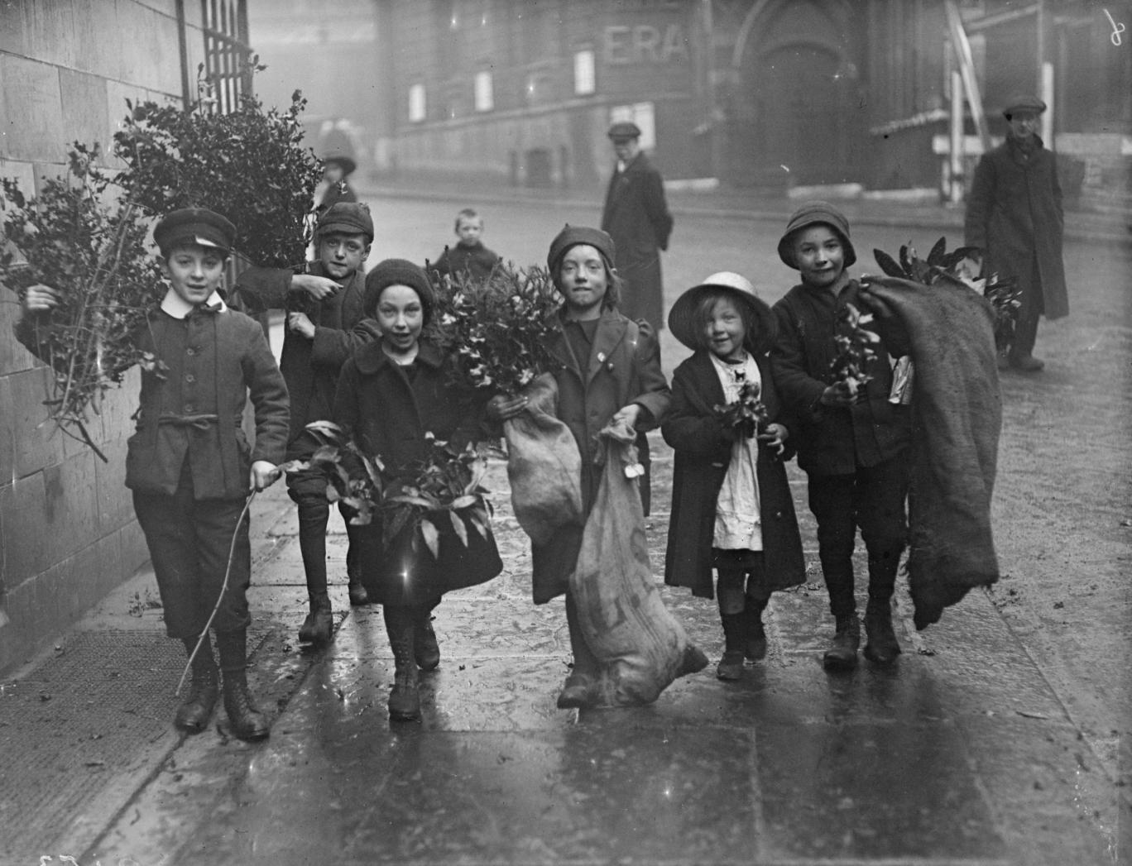
WW1 Christmas Decorations
There were few cars and many more household chores had to be done by hand like plucking turkeys or carrying the Christmas tree or decorations home.

Slide 8
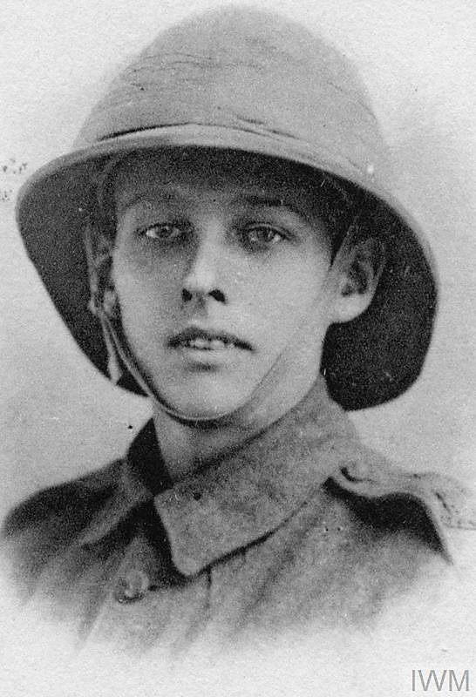
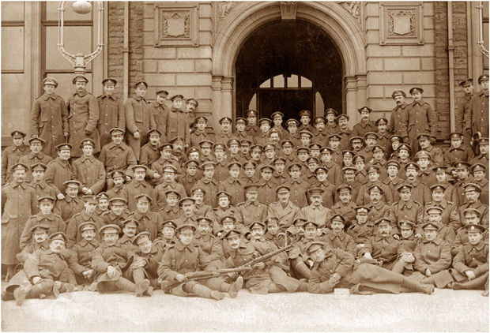
The Guy Family
George Guy volunteered to join the Isle of Wight Rifles in 1915 at the age of 18.

Slide 9
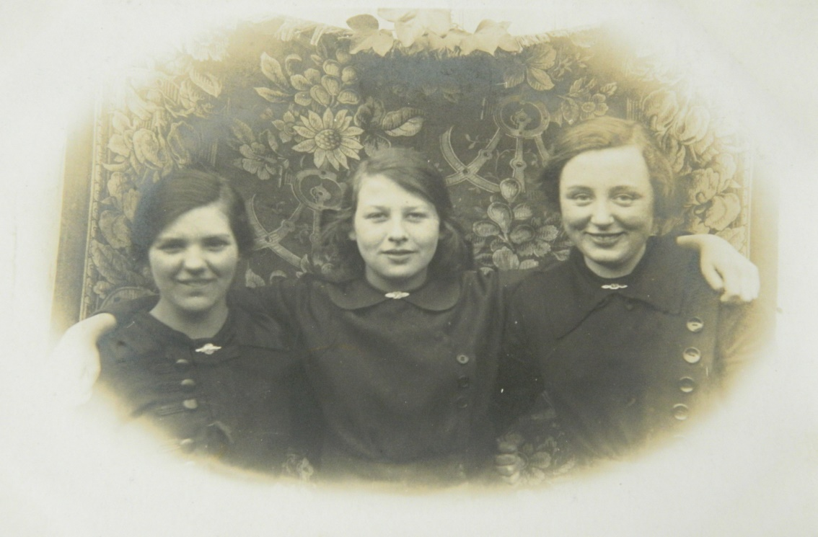
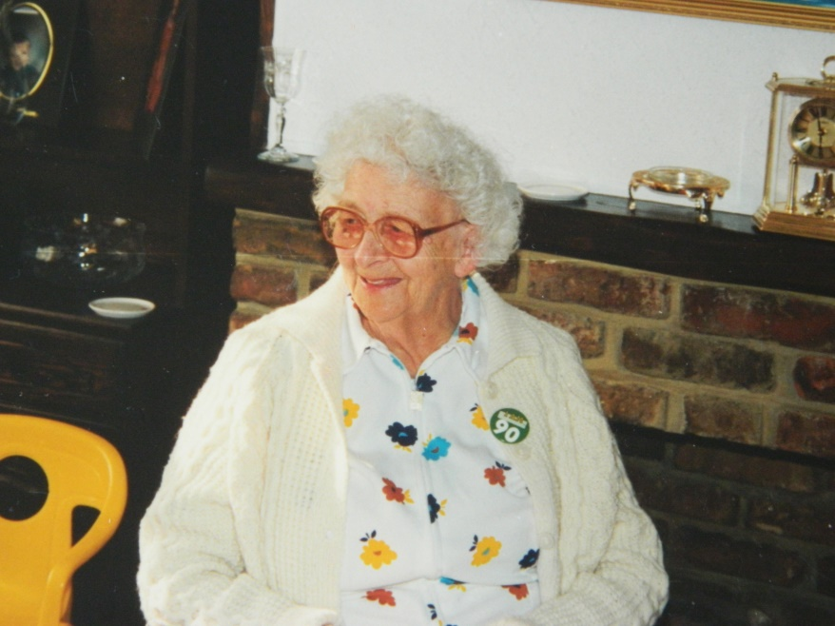
The Guy Family
Eva is shown here as a young woman with two of her friends, they are all dressed in their work uniform for a parachute factory. On the right is a photograph of Eva taken at her 90th birthday.

Slide 10
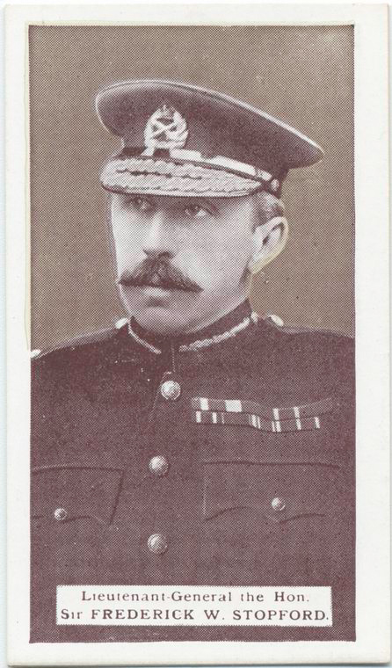
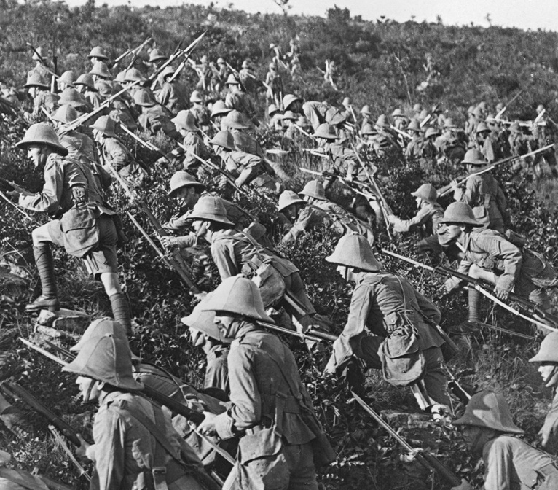
What Happened to George Guy
Gallipoli, 6th August 1915: Following the largely unopposed landing of 20,000 troops of IX Corps of the British Army at Suvla Bay on the Gallipoli peninsular, Lt Gen. Frederick Stopford, set up his command post offshore on the HMS Jonquil. Lt Gen Stopford had his men take the beaches but against the advice of his subordinate officers and unclear orders from his superiors, ordered that they rest on the beaches before taking the high ground on Tekke Tepe ridge. This was a serious mistake. By the time IX Coprs tried to occupy Tekke Tepe ridge the Turkish army had filled them full of artillery and infantry. When they had to fight on 12 August 1915, the Allies suffered 18,000 casualties at Suvla Bay and Lt General Stopford was sent home in disgrace.
George Guy died in the attack on Thursday the 12th August 1915, he was 18 years old.

Slide 11
Teachers’ Notes
Christmas revolved around going to church and the Guys were devout Christians. We know that they attended the The Greek Orthodox Church of St Barbara, St Phanourius and Paul the Apostle in Westcliff.
We know that Alice and Austin Guy and Eva Forsdick never fully recovered from the death of their son and brother. During the war Eva worked in a parachute factory. She married Austin Guy and cared for both her father and mother until they died.
Eva and her parents are buried in a family grave in North Road Burial Ground, Westcliff. George was buried in Turkey, near where he fought and died for King and Country. Eva lived to the ripe old age of 104 but never forgot her beloved brother.

Slide 12
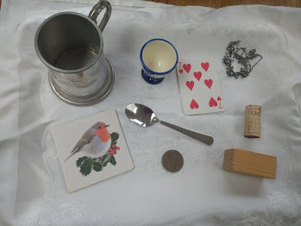
Activities
Activity: Playing old fashioned parlour games such as the Memory Game also known as Kim’s Game. Time: 20-40 minutes Resources: A tray, ten items and a cloth. Let the class look at all the items on the tray, have a member of class take one item away where they can’t be seen and then return with the tray with 9 objects and see if your class can work out which item has gone.

Slide 13
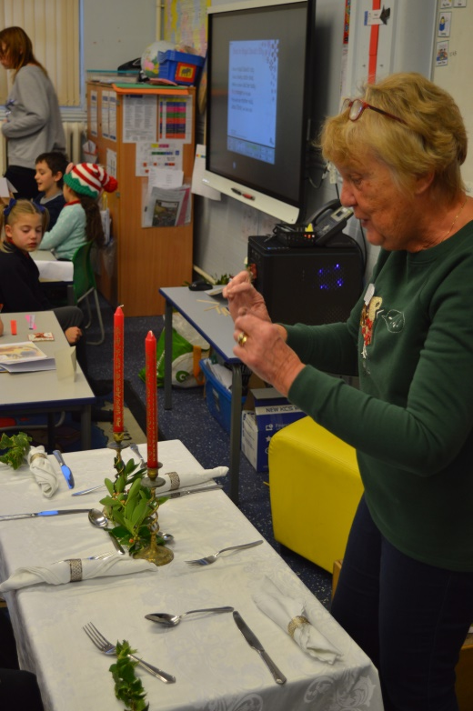
Activities
Activity: Preparing the Dinner Table
Time: 30minutes Resources: Table cloth, candle sticks with candles, cutlery, cloth serviettes, greenery, old fashioned style crackers, glasses
Demonstrate how Eva and her mother Alice would have laid the table ready for the Christmas dinner. Talk about how this would have been a big event for the family as food could often be scarce. Nothing was plastic and everything on the table would be the best that the family owned. Electricity was very new at this time, so it is likely that oil lamps and candles would have been the main lighting source. Ask your class to explain the differences between Christmas for the Guy family and how they celebrate Christmas now.

Slide 14
The Guy Family Christmas
Southend Schools Festival of Remembrance Learning Materials
www.ssfr.org.uk

